Slide 1
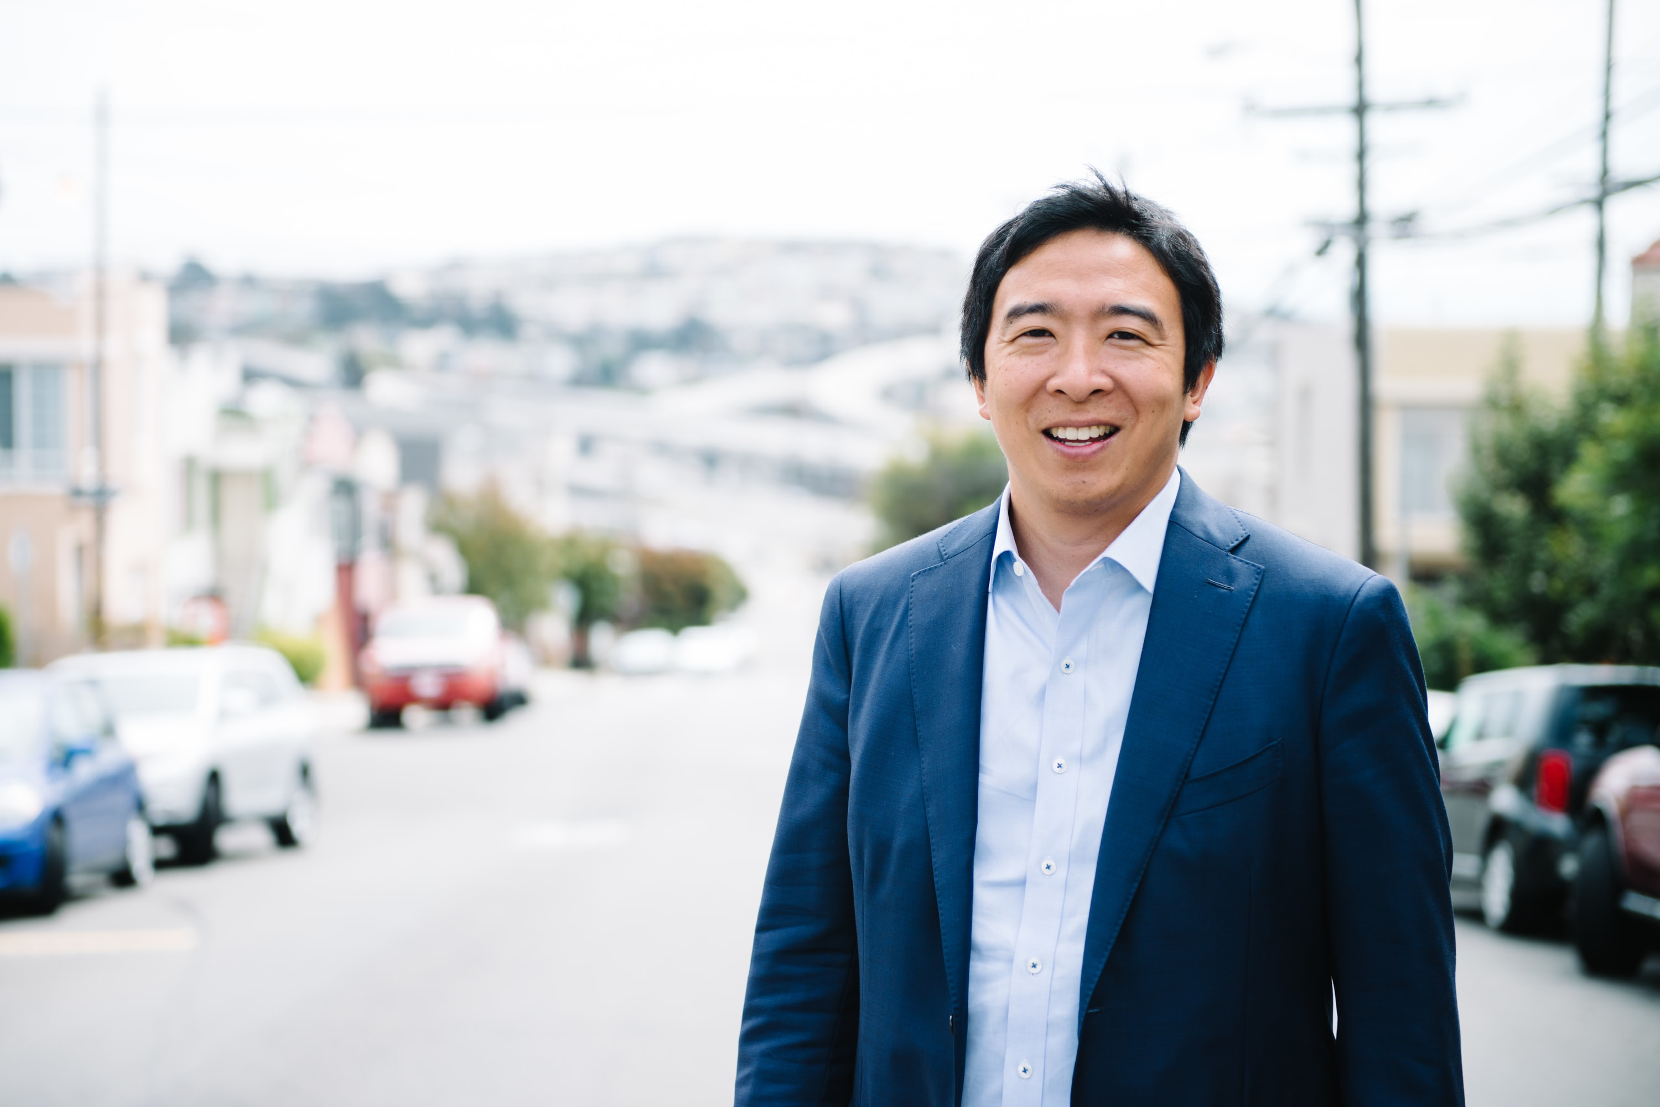

YANG POLICY
“The Freedom Dividend” (UBI)
“Technology is quickly displacing a large number of workers, and the pace will only increase as automation and other forms of artificial intelligence become more advanced. ⅓ of American workers will lose their jobs to automation by 2030…”
“The most direct and concrete way for the government to improve your life is to send you a check for $1,000 every month and let you spend it in whatever manner will benefit you the most.”
As President I will implement the Freedom Dividend, providing Universal Basic Income of $1,000/month to all American adults over the age of 18 so that we may all share in the prosperity we have contributed to and participate in the new economy.
# HumanityFirst

